Slide 1
BGP
(Part 1)
Module 2

Slide 2
Terms
IGP (Interior Gateway Protocol) - RIP, IGRP, EIGRP, OSPF = Routing protocol used to exchange routing information within an autonomous system.
EGP (Exterior Gateway Protocol) - BGP = Routing protocol used to exchange routing information between autonomous systems.
Autonomous System = (From RFC 1771) “A set of routers under the single technical administration, using an IGP and common metrics to route packets within the AS, and using an EGP to route packets to other AS’s.”
BGP is a path vector or an advanced distance vector routing protocol.
Rick Graziani graziani@cabrillo.edu

Slide 3
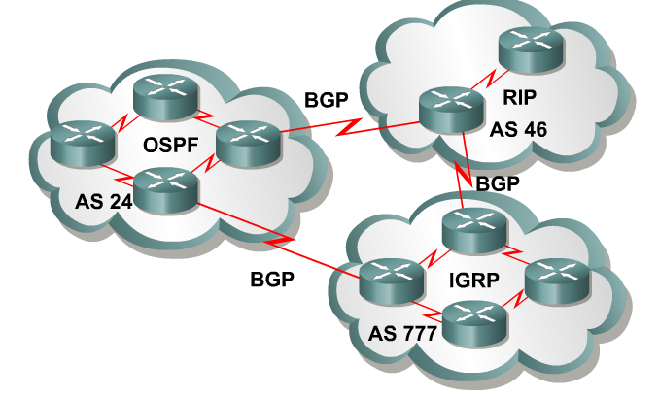
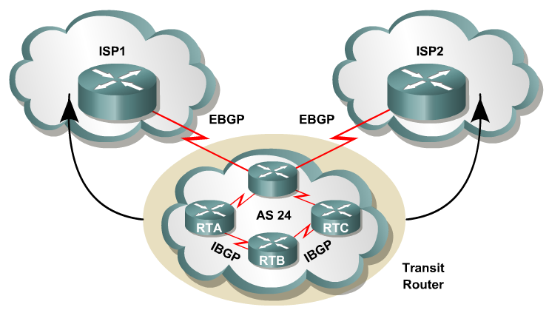
When to use BGP and when not to use BGP – Cisco CCO
Use BGP when the effects of BGP are well understood and one of the following conditions exist:
The AS allows packets to transit through it to reach another AS (transit AS).
The AS has multiple connections to other AS’s.
The flow of traffic entering or exiting the AS must be manipulated. This is policy based routing and based on attributes.
Rick Graziani graziani@cabrillo.edu

Slide 4
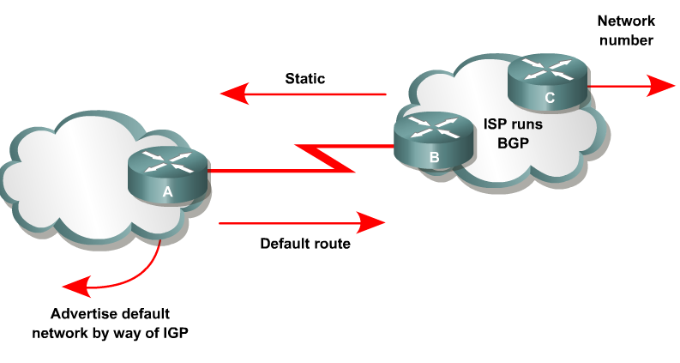
When to use BGP and when not to use BGP
Do not use BGP if you have one or more of the following conditions:
A single connection to the Internet or another AS
No concern for routing policy or routing selection
A lack of memory or processing power on your routers to handle constant BGP updates
A limited understanding of route filtering and BGP path selection process
Low bandwidth between AS’s
Rick Graziani graziani@cabrillo.edu

Slide 5
Who needs BGP?
Not as many internetworks as you may think.
“You should implement BGP only when a sound engineering reason compels you to do so, such as when the IGPs do not provide the tools necessary to implement the required routing policies or when the size of the routing table cannot be controlled with summarization.”
“The majority of the cases calling for BGP involve Internet connectivity – either between a subscriber and an ISP or (more likely) between ISPs.”
“Yet even when interconnecting autonomous systems, BGP might be unnecessary.”
Jeff Dolye, Routing TCP/IP Vol. II
Rick Graziani graziani@cabrillo.edu

Slide 6
Overview of autonomous systems
An AS is a group of routers that share similar routing policies and operate within a single administrative domain.
An AS can be a collection of routers running a single IGP, or it can be a collection of routers running different protocols all belonging to one organization.
In either case, the outside world views the entire Autonomous System as a single entity.
Rick Graziani graziani@cabrillo.edu

Slide 7
Overview of autonomous systems
AS Numbers
Each AS has an identifying number that is assigned by an Internet registry or a service provider.
This number is between 1 and 65,535.
AS numbers within the range of 64,512 through 65,535 are reserved for private use.
This is similar to RFC 1918 IP addresses.
Because of the finite number of available AS numbers, an organization must present justification of its need before it will be assigned an AS number.
Rick Graziani graziani@cabrillo.edu

Slide 8
Overview of autonomous systems
Today, the Internet Assigned Numbers Authority (IANA) is enforcing a policy whereby organizations that connect to a single provider and share the provider's routing policies use an AS number from the private pool, 64,512 to 65,535.
Rick Graziani graziani@cabrillo.edu

Slide 9
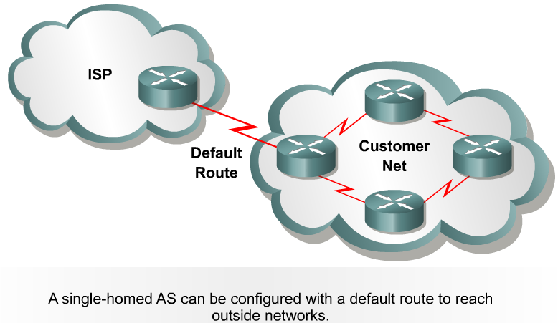
Single-homed autonomous systems
Static Route
If an AS has only one exit point to outside networks, it is considered a single-homed system.
Single-homed autonomous systems are often referred to as stub networks or stubs.
Stubs can rely on a default route to handle all traffic destined for non-local networks.
BGP is not normally needed in this situation.
Rick Graziani graziani@cabrillo.edu

Slide 10
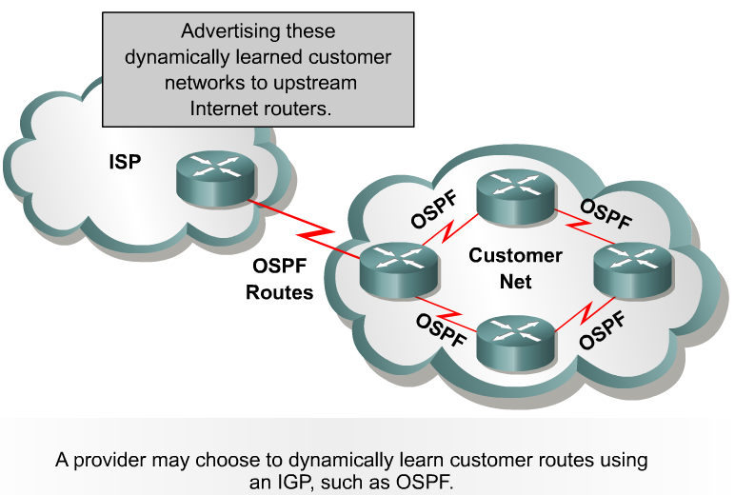
Single-homed autonomous systems
Use an IGP – Both the provider and the customer use an IGP to share information regarding the customer's networks.
This provides the benefits associated with dynamic routing.
BGP is not normally needed in this situation.
Rick Graziani graziani@cabrillo.edu

Slide 11
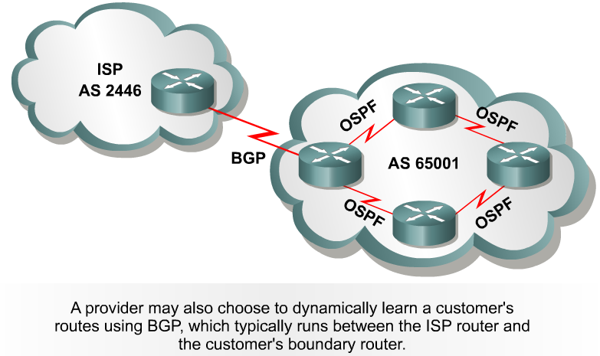
Single-homed autonomous systems
Use an EGP – The third method by which the ISP can learn and advertise the customer's routes is to use an EGP such as BGP.
In a single-homed autonomous system the customer's routing policies are an extension of the policies of the provider.
  For this reason the Internet number registries are unlikely to assign an AS number.
  Instead, the provider can give the customer an AS number from the private pool of AS numbers, 64,512 to 65,535.
  The provider will strip off these numbers when advertising the customer's routes towards the core of the Internet.
Rick Graziani graziani@cabrillo.edu

Slide 12
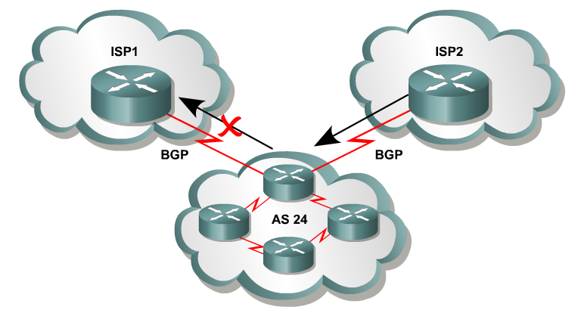

Multihomed nontransit autonomous systems
Or same ISP
An AS is a multihomed system if it has more than one exit point to outside networks.
A non-transit AS does not allow transit traffic-that is, any traffic that has a source and destination outside the AS—to pass through it.
A non-transit AS would advertise only its own routes to both the providers it connects to—it would not advertise routes it learned from one provider to another.
This makes certain that ISP1 will not use AS 24 to reach destinations that belong to ISP2, and ISP2 would not use AS 24 to reach destinations that belong to ISP1.
Rick Graziani graziani@cabrillo.edu

Slide 13
Multihomed nontransit autonomous systems
Or same ISP
Multihomed nontransit autonomous systems do not really need to run BGP4 with their providers.
It is usually recommended and often required by ISPs.
As it will be seen later in this module, BGP4 offers numerous advantages, including increased control of route propagation and filtering.
Rick Graziani graziani@cabrillo.edu

Slide 14
Multihomed nontransit autonomous systems
Incoming route advertisements influence your outgoing traffic, and outgoing advertisements influence your incoming traffic.
If the provider advertises routes into your AS via BGP, your internal routers have more accurate information about external destinations.
  BGP also provides tools for setting routing policies for external destinations.
If your internal routes are advertised to the provider via BGP, you have influence over which routes are advertised at which exit point.
  BGP also provides tools for your influencing (to some degree) the choices the provider makes when sending traffic into your AS.
Rick Graziani graziani@cabrillo.edu

Slide 15
Multi-homed Transit Autonomous Systems
A multi-homed transit system has more than one connection to the outside world and can be used for transit traffic by other autonomous systems.
  From the point of view of the multi-homed AS, transit traffic is any traffic originating from outside sources bound for outside destinations
Rick Graziani graziani@cabrillo.edu

Slide 16
Multi-homed Transit Autonomous Systems
Edge Router
When BGP is running inside an AS, it is referred to as Internal BGP (IBGP).
When BGP runs between autonomous systems, it is called External BGP (EBGP).
If the role of a BGP router is to route IBGP traffic, it is called a transit router.
Routers that sit on the boundary of an AS and that use EBGP to exchange information with the ISP are called border or edge routers.
Rick Graziani graziani@cabrillo.edu

Slide 17
BGP Hazards – Inadvertent Transit Domain
We inadvertently advertise routes learned from ISP2 to ISP1.
ISP1 customers will see our network as the best path to ISP2 customers.
We have become a transit domain for packets from ISP1 to ISP2.
Rick Graziani graziani@cabrillo.edu

Slide 18
BGP Basics
BGP is a path vector routing protocol.
Defined in RFC 1772
BGP is a distance vector routing protocol, in that it relies on downstream neighbors to pass along routes from their routing table.
BGP uses a list of AS numbers through which a packet must pass to reach a destination.
Rick Graziani graziani@cabrillo.edu

Slide 19
BGP Basics
The function of BGP is to:
  Exchange routing information between autonomous systems
  Guarantee the selection of a loop free path.
BGP4 is the first version of BGP that supports CIDR and route aggregation.
Common IGPs such as RIP, OSPF, and EIGRP use technical metrics.
  BGP does not use technical metrics.
BGP makes routing decisions based on network policies, or rules (later)
BGP does not show the details of topologies within each AS.
BGP sees only a tree of autonomous systems.
Cisco routers maintain a separate routing table to hold BGP routes – show ip bgp – later.
Rick Graziani graziani@cabrillo.edu

Slide 20
BGP Basics
BGP updates are carried using TCP on port 179.
  In contrast, RIP updates use UDP port 520
  OSPF, IGRP, EIGRP does not use a Layer 4 protocol
Because BGP requires TCP, IP connectivity must exist between BGP peers.
TCP connections must also be negotiated between them before updates can be exchanged.
Therefore, BGP inherits those reliable, connection-oriented properties from TCP.
Rick Graziani graziani@cabrillo.edu

Slide 21
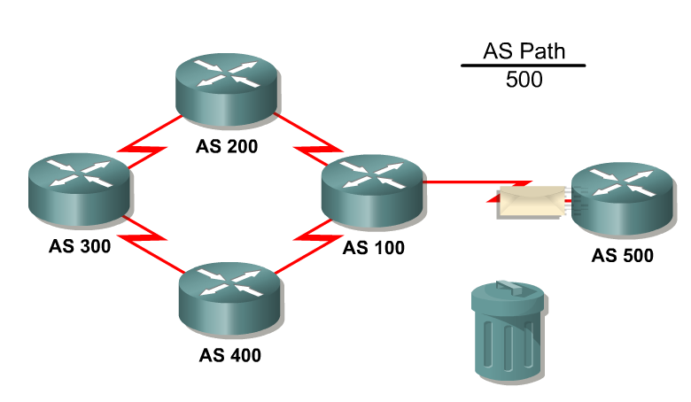
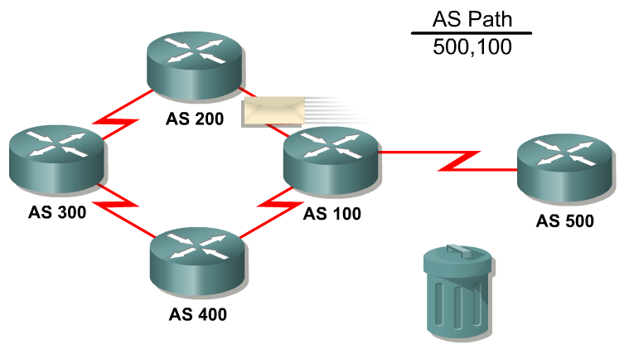
Loop Free Path
To guarantee loop free path selection, BGP constructs a graph of autonomous systems based on the information exchanged between BGP neighbors.
BGP views the whole internetwork as a graph, or tree, of autonomous systems.
The connection between any two systems forms a path.
The collection of path information is expressed as a sequence of AS numbers called the AS Path.
This sequence forms a route to reach a specific destination
Rick Graziani graziani@cabrillo.edu

Slide 22
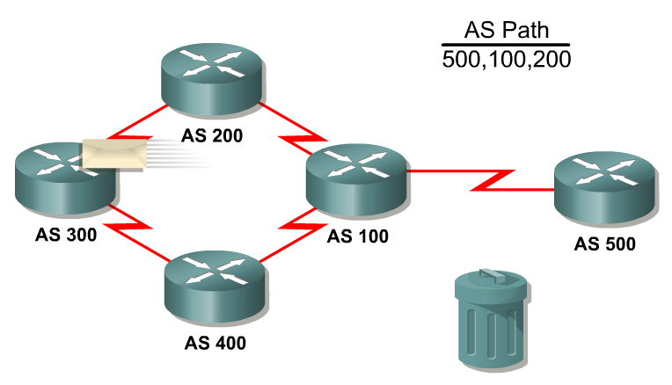
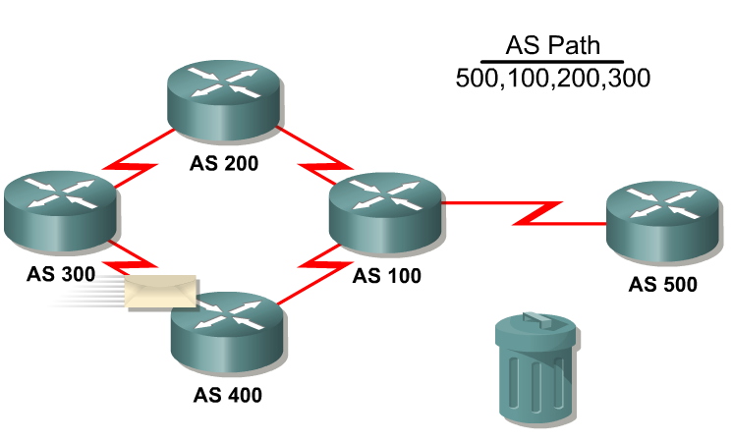
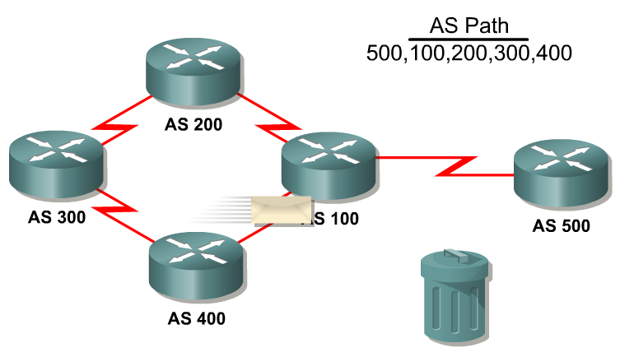
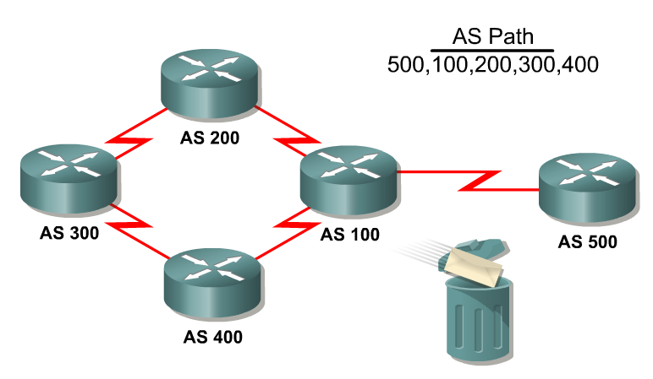
1
2
3
4
5
6
Sees its own AS
Rick Graziani graziani@cabrillo.edu

Slide 23
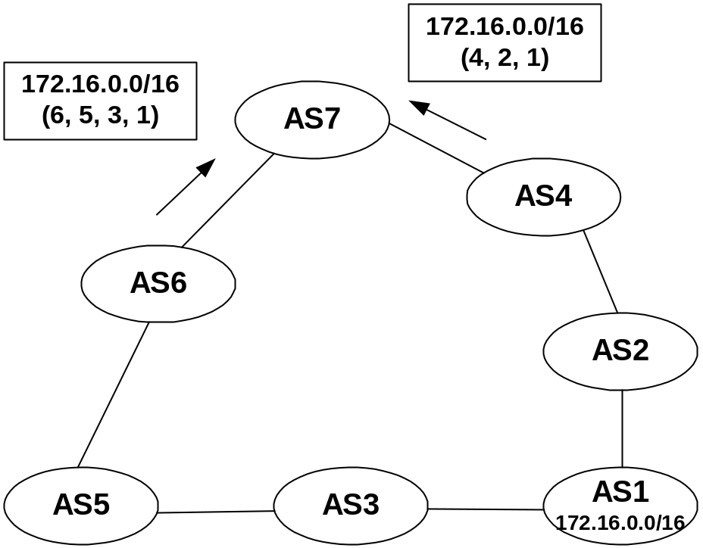
Loop Free Path
The list of AS numbers associated with a BGP route is called the AS_PATH and is one of several path attributes associated with each route.
Path attributes will be discussed in much more detail later.
The shortest inter-AS path is very simply determined by the least number of AS numbers.
All things being equal, BGP prefers routes with shorter AS paths.
In this example, AS7 will choose the shortest path (4, 2, 1).
We will see later what happens with equal cost paths.
Rick Graziani graziani@cabrillo.edu

Slide 24
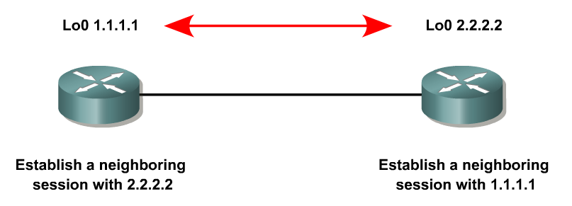
BGP Operation
When two routers establish a TCP-enabled BGP connection between each other, they are called neighbors or peers.
Each router running BGP is called a BGP speaker.
Rick Graziani graziani@cabrillo.edu

Slide 25
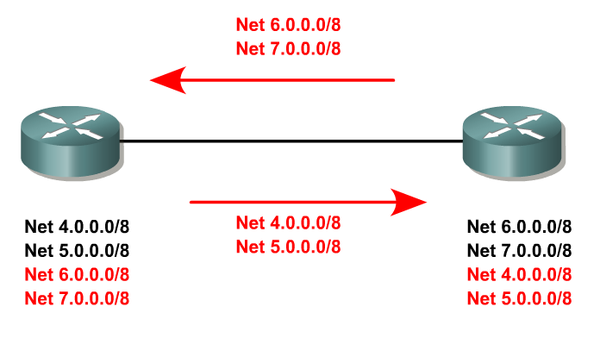
Initial Exchange
When BGP neighbors first establish a connection, they exchange all candidate BGP routes.
After this initial exchange, incremental updates are sent as network information changes.
Rick Graziani graziani@cabrillo.edu

Slide 26
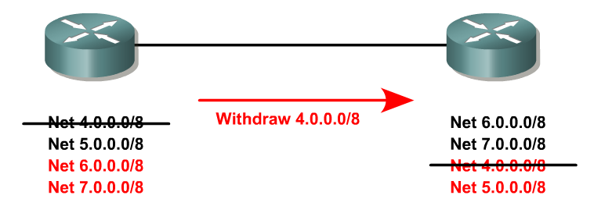
Withdrawn Routes
The information for network reachability can change, such as when a route becomes unreachable or a better path becomes available.
BGP informs its neighbors of this by withdrawing the invalid routes and injecting the new routing information.
Withdrawn routes are part of the update message. BGP routers keep a table version number that tracks the version of the BGP routing table received from each peer.
If the table changes, BGP increments the table version number.
A rapidly incrementing table version is usually an indication of instabilities in the network, or a misconfiguration.
Rick Graziani graziani@cabrillo.edu

Slide 27
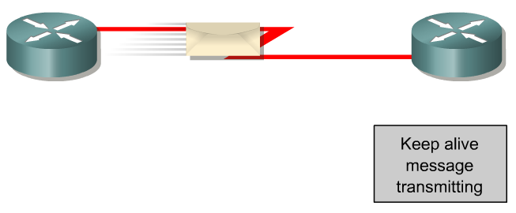
BGP Keepalives
Peers exchange keepalive messages to ensure the connection is maintained.
The Cisco default keepalive interval is 60 seconds (RFC 1771 does not specify a standard time).
If three keepalive intervals (180 seconds) pass the peer declares its neighbor down.
These can be modified with timers bgp command.
Rick Graziani graziani@cabrillo.edu

Slide 28
BGP Message Types
Before establishing a BGP peer connection the two neighbors must perform the standard TCP three-way handshake and open a TCP connection to port 179.
After the TCP session is established, BGP peers exchanges several messages to open and confirm connection parameters and to send BGP routing information.
All BGP messages are unicast to the one neighbor over the TCP connection.
There are four BGP message types:
  Type 1: OPEN
  Type 2: KEEPALIVE
  Type 3: UPDATE
  Type 4: NOTIFICATION
Rick Graziani graziani@cabrillo.edu

Slide 29
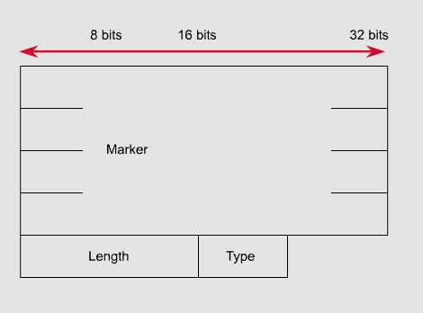
BGP Message Types
Each BGP Message contains the following header:
Marker: The marker field is used to either authenticate incoming BGP messages or to detect loss of synchronization between two BGP peers.
Length: The length field indicates the total BGP message length, including the header.
Rick Graziani graziani@cabrillo.edu

Slide 30
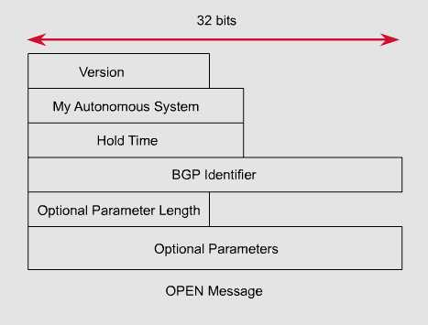
Type 1:
BGP Open Message
After the TCP session is established, both neighbors send Open messages.
This message is used to establish connections with peers.
Each neighbor uses this message to identify itself and to specify its BGP operational parameters including:
  BGP version number (defaults to version 4)
  AS number: AS number of the originating router, determines if BGP session is EBGP or IBGP.
  BGP identifier: IP address that identifies the neighbor using the same method as OSPF router ID.
  Optional parameter: authentication, multiprotocol support and route refresh.
Rick Graziani graziani@cabrillo.edu

Slide 31
Type 2: BGP Keepalive Message
This message type is sent periodically between peers to maintain connections and verify paths held by the router sending the keepalive.
If a router accepts the parameters specified in its neighbor’s Open message, it responds with a Keepalive.
Subsequent Keepalives are sent every 60 seconds by Cisco default or equal to one-third the agreed-upon hold time (180 seconds).
If the periodic timer is set to a value of zero (0), no keepalives are sent.
Rick Graziani graziani@cabrillo.edu

Slide 32
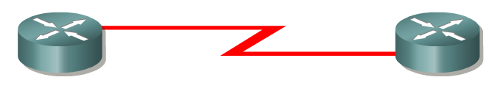
Type 3: BGP Update Message
The UPDATE messages contain all the information BGP uses to construct a loop-free picture of the internetwork.
Update messages advertises feasible routes, withdrawn routes, or both.
The three basic components of an UPDATE message are:
  Network-Layer Reachability Information (NLRI)
  Path Attributes
  Withdrawn Routes
Rick Graziani graziani@cabrillo.edu

Slide 33
Type 3: BGP Update Message
Network-Layer Reachability Information (NLRI)
This is one or more (Length, Prefix) tuples that advertise IP address prefixes and their lengths.
192.168.160.0/19
  Prefix = 192.168.160.0
  Prefix Length = 19
Path Attributes
This is described later, providing the information that allows BGP to choose a shortest path, detect routing loops, and determine routing policy.
Withdrawn Routes
These are (Length, Prefix) tuples describing destination that have become unreachable and are being withdrawn from service.
An update message that has no NLRI or path attribute information is used to advertise only routes to be withdrawn from service.
Rick Graziani graziani@cabrillo.edu

Slide 34
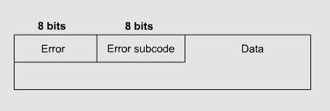
Type 4: BGP Notification Message
A NOTIFICATION message is sent whenever an error is detected and always causes the BGP connection to close.
The NOTIFICATION message is composed of the Error Code (8 bits), Error Subcode (8 bits), and a Data fields (variable length).
Rick Graziani graziani@cabrillo.edu

Slide 35
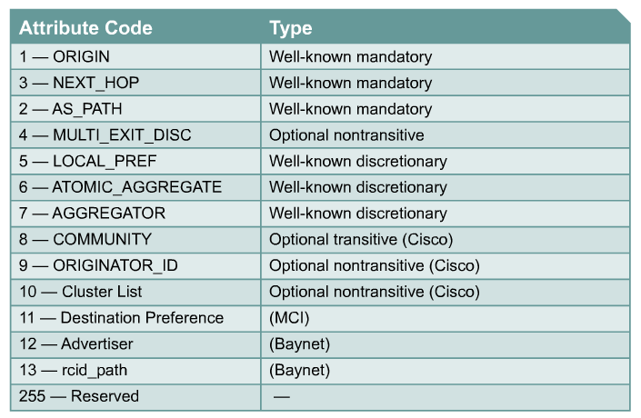
Path Attributes
Much of the work you will do configuring BGP focuses on path attributes.
Each route has its own set of defined attributes, which can include path information, route preference, next-hop, and aggregation information.
Administrators use these values to enforce routing policy.
Based on attribute values, you can configure BGP to filter routing information, prefer certain paths, or otherwise customize its behavior.
Every UPDATE message has a variable-length sequence of path attributes in the form <attribute type, attribute length, attribute value>.
Rick Graziani graziani@cabrillo.edu

Slide 36
Path Attributes
Since you will use path attributes extensively when configuring routing policy, you should note that not all vendor implementations of BGP recognize the same attributes.
In fact, path attributes come in four different types:
  Well-known mandatory
  Well-known discretionary
  Optional transitive
  Optional non-transitive
Rick Graziani graziani@cabrillo.edu

Slide 37
Path Attributes
Well-known mandatory
An attribute that has to exist in the BGP UPDATE packet.
It must be recognized by all BGP implementations.
If a well-known attribute is missing, a notification error will be generated; this ensures that all BGP implementations agree on a standard set of attributes.
  Example: AS_PATH attribute.
Rick Graziani graziani@cabrillo.edu

Slide 38
Path Attributes
Well-known discretionary
An attribute that is recognized by all BGP implementations
But may or may not be sent in the BGP UPDATE message.
Example: LOCAL_PREF
Rick Graziani graziani@cabrillo.edu

Slide 39
Path Attributes
Optional transitive
An attribute that may or may not be, recognized by all BGP implementations (thus, optional).
Because the attribute is transitive, BGP should accept and advertise the attribute even if it isn’t recognized.
Example: COMMUNITY
Rick Graziani graziani@cabrillo.edu

Slide 40
Path Attributes
Optional non-transitive
An attribute that may or may not be, recognized by all BGP implementations.
Whether or not the receiving BGP router recognizes the attribute, it is non-transitive, and should not be passed along to other BGP peers.
Example: ORIGINATOR_ID
Rick Graziani graziani@cabrillo.edu

Slide 41
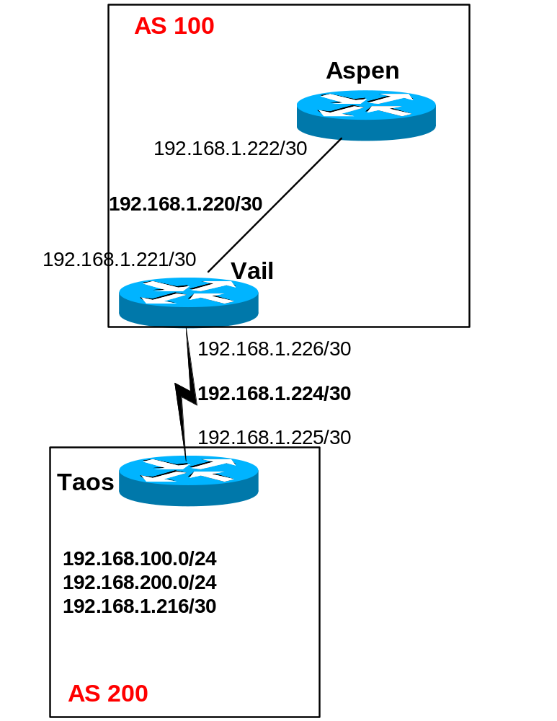
IBGP vs EBGP
…
When BGP is running inside an AS, it is referred to as Internal BGP (IBGP).
  If a BGP router’s role is to route IBGP traffic, it is called a transit router.
When BGP runs between autonomous systems, it is called External BGP (EBGP).
  Routers that sit on the boundary of an AS and use EBGP to exchange information with the ISP are called border routers.
“With very few exceptions, interior BGP (IBGP) – BGP between peers in the same AS – is used only in multihomed scenarios.” – Doyle
IBGP
EBGP
Rick Graziani graziani@cabrillo.edu

Slide 42
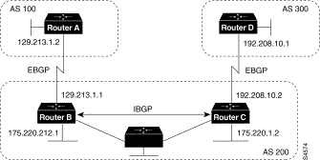
Routers A and B are running EBGP (BGP), and Routers B and C are running IBGP.
Note that the EBGP (BGP) peers are directly connected and that the IBGP peers are not. (They can be.)
As long as there is an IGP running that allows the two neighbors to reach one another, IBGP peers do not have to be directly connected.
More later!
Rick Graziani graziani@cabrillo.edu

Slide 43
All BGP speakers within an AS must establish a peer relationship with each other, that is, the BGP speakers within an AS must be fully meshed logically. (later)
AS 200 is a transit AS for AS 100 and AS 300---that is, AS 200 is used to transfer packets between AS 100 and AS 300.
Rick Graziani graziani@cabrillo.edu

Slide 44
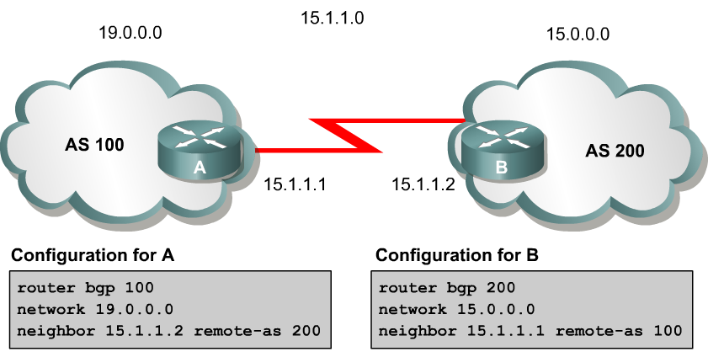
BGP Configuration
To begin configuring a BGP process, issue the following familiar command:
Router(config)#router bgp AS-number
BGP configuration commands appear on the surface to mirror the syntax of familiar IGP (for example, RIP, OSPF) commands.
Although the syntax is similar, the function of these commands is significantly different.
Note: Cisco IOS permits only one BGP process to run at a time, thus, a router cannot belong to more than one AS.
Rick Graziani graziani@cabrillo.edu

Slide 45
BGP Configuration
Router(config-router)#network network-number [mask network-mask]
The network command is used with IGPs, such as RIP, to determine the interfaces on which to send and receive updates, as well as which directly connected networks to advertise.
However, when configuring BGP, the network command does not affect what interfaces BGP runs on.
In BGP, the network command tells the BGP process what locally learned networks to advertise.
The networks can be connected routes, static routes, or routes learned via a dynamic routing protocol, such as RIP.
  Thus, configuring just a network statement will not establish a BGP neighbor relationship. This is a major difference between BGP and IGPs.
Rick Graziani graziani@cabrillo.edu

Slide 46
BGP Configuration
network command continued…
These networks must also exist in the local router’s routing table (show ip route), or they will not be sent out in updates.
You can use the mask keyword with the network command to specify individual subnets.
Routes learned by the BGP process are propagated by default, but are often filtered by a routing policy.
Rick Graziani graziani@cabrillo.edu

Slide 47
BGP Configuration
Router(config-router)#neighbor ip-address remote-as AS-number
In order for a BGP router to establish a neighbor relationship with another BGP router, you must issue the this configuration command.
This command serves to identify a peer router with which the local router will establish a session.
The AS-number argument determines whether the neighbor router is an EBGP or an IBGP neighbor.
Rick Graziani graziani@cabrillo.edu

Slide 48
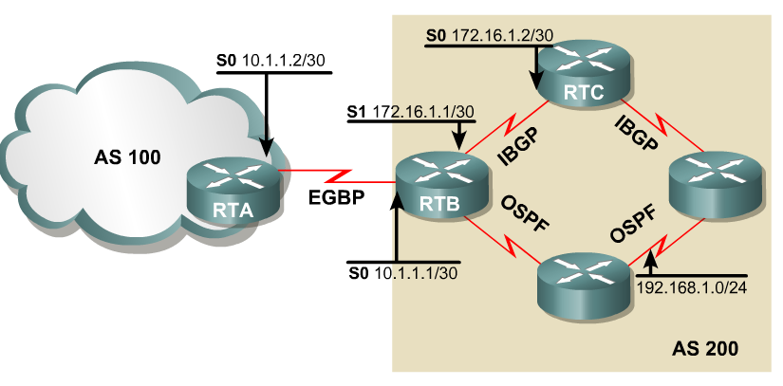
BGP Configuration
If the AS-number configured in the router bgp command is identical to the AS-number configured in the neighbor statement, BGP will initiate an internal session - IBGP.
If the field values are different, BGP will build an external session - EBGP.
Rick Graziani graziani@cabrillo.edu

Slide 49
EBGP
RTA(config)#router bgp 100
RTA(config-router)#neighbor 10.1.1.1 remote-as 200
RTB(config)#router bgp 200
RTB(config-router)#neighbor 10.1.1.2 remote-as 100
RTB: Note that the neighbor command’s remote-as value, 100, is different from the AS number specified by the router bgp command (200).
Because the two AS numbers are different, BGP will start an EBGP connection with RTA.
Communication will occur between autonomous systems.
Rick Graziani graziani@cabrillo.edu

Slide 50
IBGP
RTB(config)#router bgp 200
RTB(config-router)#neighbor 172.16.1.2 remote-as 200
RTB(config-router)#neighbor 172.16.1.2 update-source loopback 0
RTC(config)#router bgp 200
RTC(config-router)#neighbor 172.16.1.1 remote-as 200
RTC(config-router)#neighbor 172.16.1.1 update-source loopback 0
Since the remote-as value (200) is the same as RTB’s BGP AS number, BGP recognizes that this connection will occur within AS 200, so it attempts to establish an IBGP session.
In reality, AS 200 is not a remote AS at all; it is the local AS, since both routers live there. But for simplicity, the keyword remote-as is used when configuring both EBGP and IBGP sessions.
Rick Graziani graziani@cabrillo.edu

Slide 51
RTB(config-router)#neighbor 172.16.1.2 update-source loopback 0
RTC(config-router)#neighbor 172.16.1.1 update-source loopback 0
The update-source loopback 0 command is used to instruct the router to use any operational interface for TCP connections (as long as Lo0 is up and configured with an IP address).
Without the update-source loopback 0 command, BGP routers can use only the closest IP interface to the peer.
The ability to use any operational interface provides BGP with robustness in the event the link to the closet interface fails.
  Since EBGP sessions are typically point-to-point, there is no need to use this command with EBGP.
Rick Graziani graziani@cabrillo.edu

Slide 52
Assume the following route appears in RTB’s table:
0 192.168.1.0/24 [110/74] via 10.2.2.1, 00:31:34, Serial2
RTB learned this route via an IGP, in this case, OSPF.
This AS uses OSPF internally to exchange route information.
Can RTB advertise this network via BGP?
Certainly, redistributing OSPF into BGP will do the trick, but the BGP network command will do the same thing.
Rick Graziani graziani@cabrillo.edu

Slide 53
RTB(config)#router bgp 200
RTB(config-router)#network 172.16.1.0 mask 255.255.255.254
RTB(config-router)#network 10.1.1.0 mask 255.255.255.254
RTB(config-router)#network 192.168.1.0
The first two network commands in include the mask keyword, so that only a particular subnet is specified.
The third network command results in the OSPF route being advertised by BGP without redistribution.
Remember that the BGP network command works differently than the IGP network command!
Rick Graziani graziani@cabrillo.edu

